Slide 1
Mechanics of respiration
Dr. D T D Warnakulasuriya
Department of Physiology
Faculty of Medicine
University of Kelaniya

Slide 2
Objectives
Compliance
Recoil tendency
Elasticity
Lung compliance
Lung elastance
Surface tension
Role of surfactant
Disorders associated with surfactant deficiency/ excess

Slide 3
Compliance
Is the ability of the lungs to expand / distensibility
Is the volume change per unit pressure change
∆V/∆P
Normal compliance is approximately 0.2 L/cm H₂O

Slide 4
Compliance measures how easy it is to inflate something
If it is easy to inflate something, then compliance is high
If it is hard to inflate something, then compliance is low
The compliance of the lungs, chest wall and the respiratory system can be studied by studying the volume changes in the respiratory system against the pressure changes across the respective structure

Slide 5
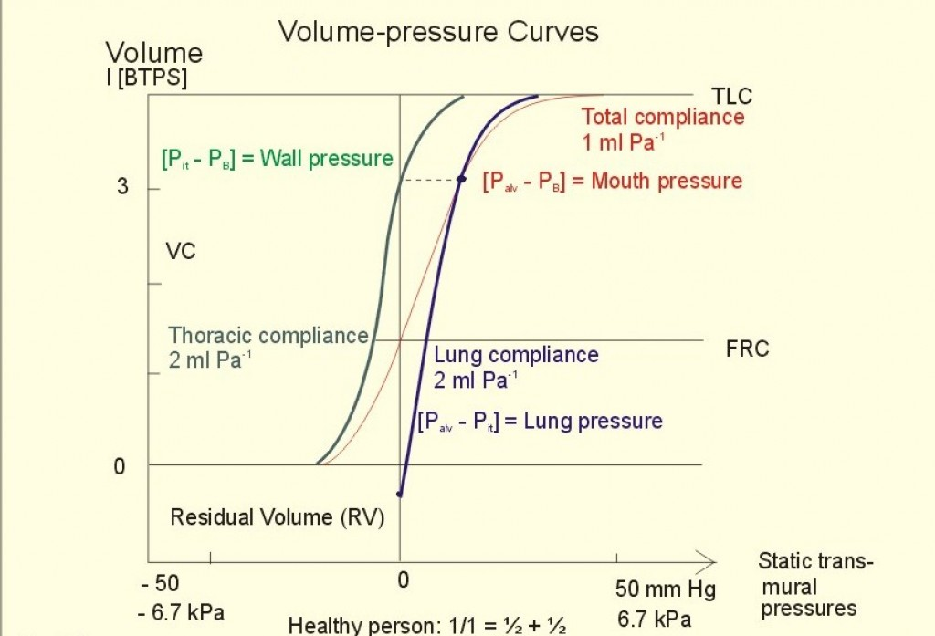
The steepest relationship between the volume and the pressure exists in volumes closer to the functional residual capacity (FRC). Compliance is highest at lung volumes closer to FRC. This enables the lungs to inflate easily during tidal breathing.
Relaxation volume
Relaxation pressure

Slide 6
The curves tend to flatten as the volume reaches the TLC
The compliance becomes less when the lungs and the respiratory system are maximally inflated

Slide 7
The total compliance (compliance of the lungs and thorax combined ) is less than the compliance of either one alone

Slide 8
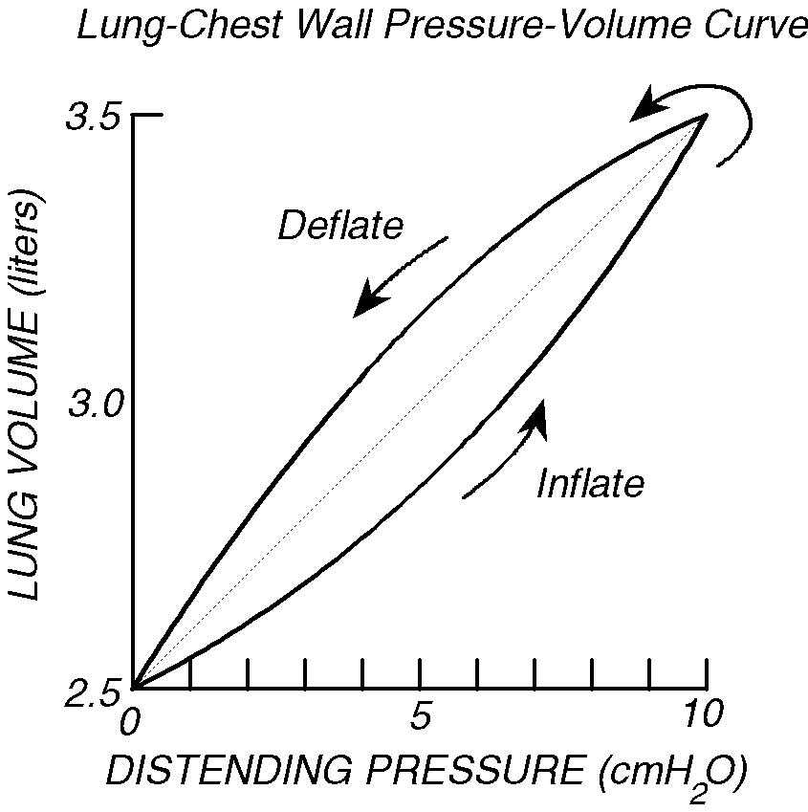
Hysteresis
This means that the compliance is different on inspiration and expiration
The lung volume at any given pressure during deflation is larger than during inflation.
Main factors that cause hysteresis
Surfactant
Collapse of air ways
Notes:
With surfactant present inflation is easier- cause the inspiratory loop
At higher pressures small air ways collapse causing a higher volume.

Slide 9
Changes in lung compliance
Low lung compliance
Indicates a stiff lung
This means extra work is required to bring in a normal volume of air.
Example: lung fibrosis
High lung compliance
A highly compliant lung results from poor elastic recoil
There is no problem in inflating the lungs, but extreme difficulty in exhalation
Example: emphysema

Slide 10
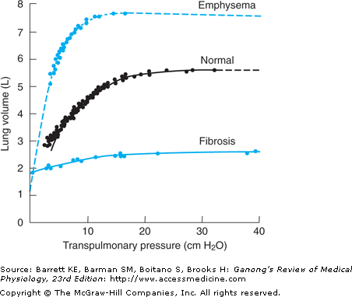

Slide 11
What is
Static compliance? Compliance with no movement of air into or out of the lungs
Dynamic compliance? Compliance during periods of gas flow
Specific compliance? Compliance measured per unit lung volume

Slide 12
Elasticity
Property of a material to change its shape when force is applied and to return to its initial shape when the force is removed
Elastic properties of the lung (elastance) is important to bring about quiet expiration
Elasticity/ recoil tendency opposes lung inflation

Slide 13
Elastance ( Elastic resistance)
The resistance to expansion
is the reciprocal of compliance
Elastance = 1/Compliance= ∆P/ ∆V
Contributes to the recoil tendency

Slide 14
The elastance of the respiratory system
= elastance of the lungs + elastance of the chest wall
Elastance of lungs
Elastic recoil forces exerted by elastin fibres in the pulmonary interstitium
Forces due to the surface tension occurring at the air-interstitial fluid interface

Slide 15
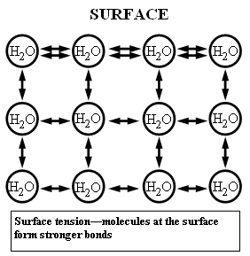
SURFACE TENSION
The cohesive forces between liquid molecules are responsible for the phenomenon known as surface tension. The molecules at the surface of water do not have other water molecules on all sides of them and consequently they cohere more strongly to those directly associated with them

Slide 16


SURFACE TENSION

Slide 17
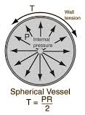
LaPlace's Law
The larger the vessel radius, the larger the wall tension required to withstand a given internal fluid pressure.
Tension in the wall of a sphere(T) = transmural pressure (P) x radius (r)
2

Slide 18
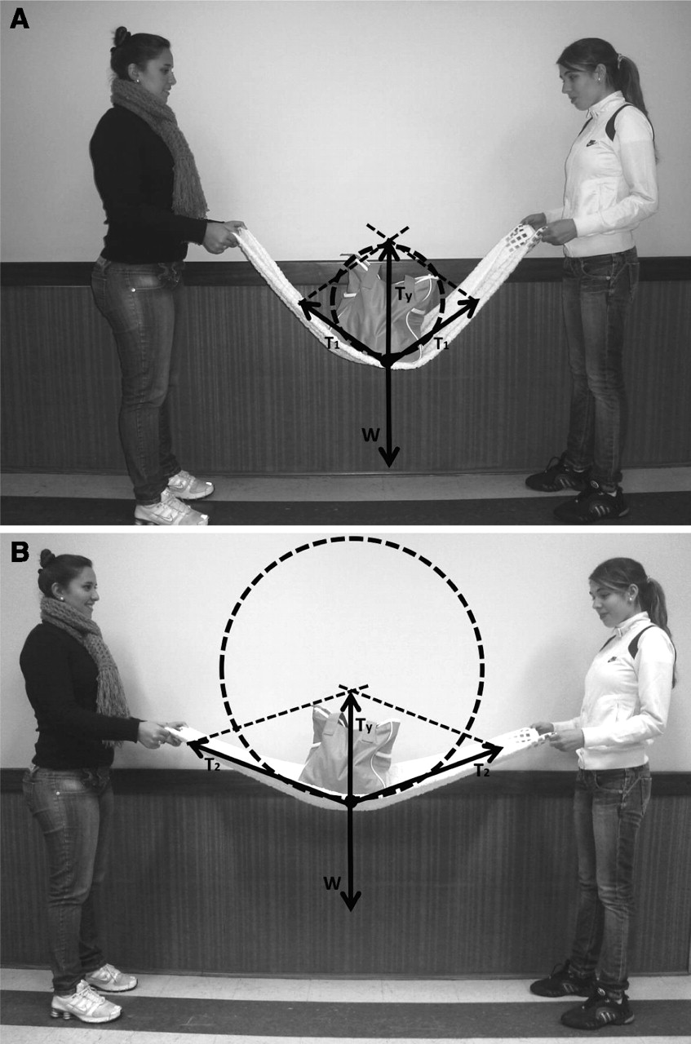

Slide 19
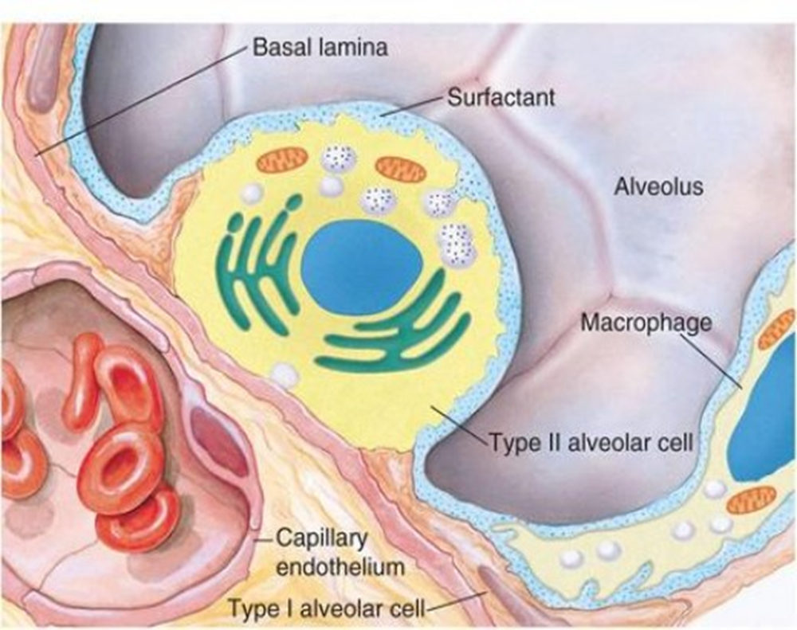
Formation of Surfactant
90% lipids (of which 2/3rd is dipalmitoyl phosphatidyl choline)
10% protein
Secreted in response to beta adrenergic stimulation and the synthesis is increased by corticosteroids
Acts as a detergent and converts the air-fluid interface into an air-surfactant interface

Slide 20
Functions of surfactant
Decreases surface tension and prevents collapse of alveoli
Stabilizes alveoli so that small alveoli do not empty in to large alveoli during expiration
Reduces fluid transudation in to alveolar spaces

Slide 21
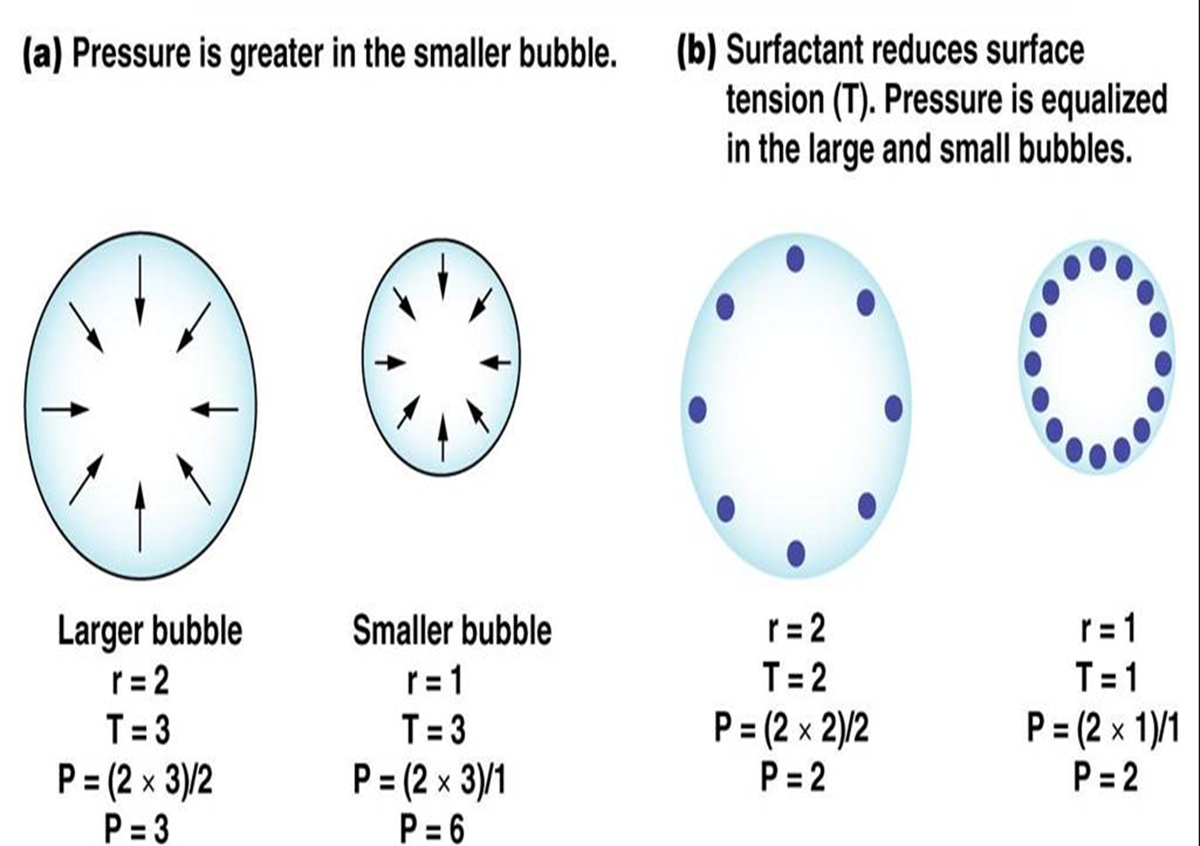
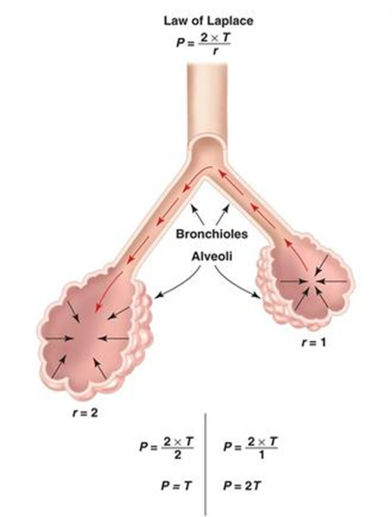

Slide 22

Stabilizes alveoli so that small alveoli do not empty in to large alveoli during expiration

Slide 23
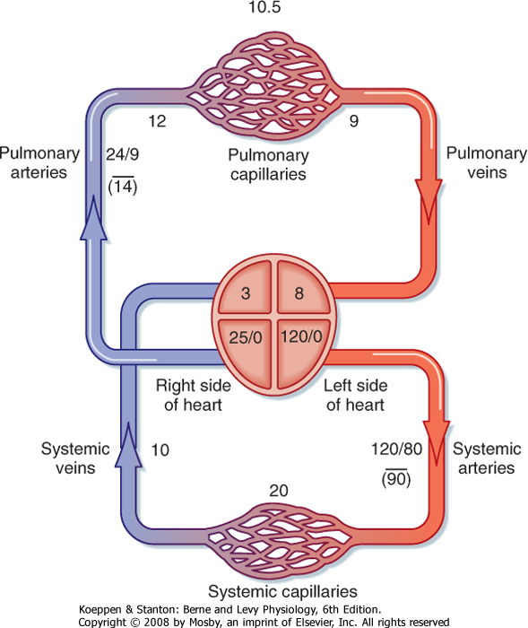
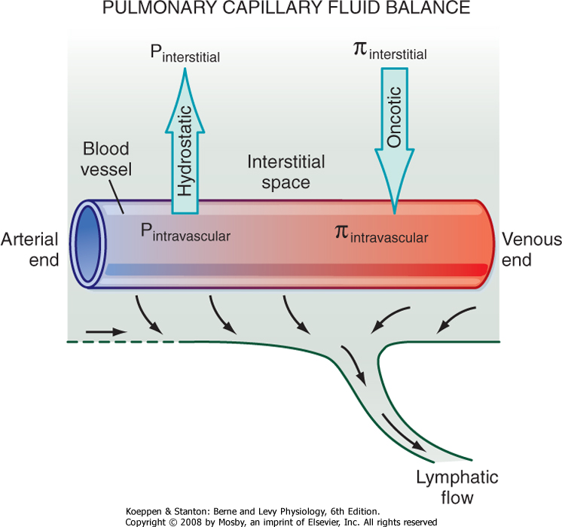

Slide 24
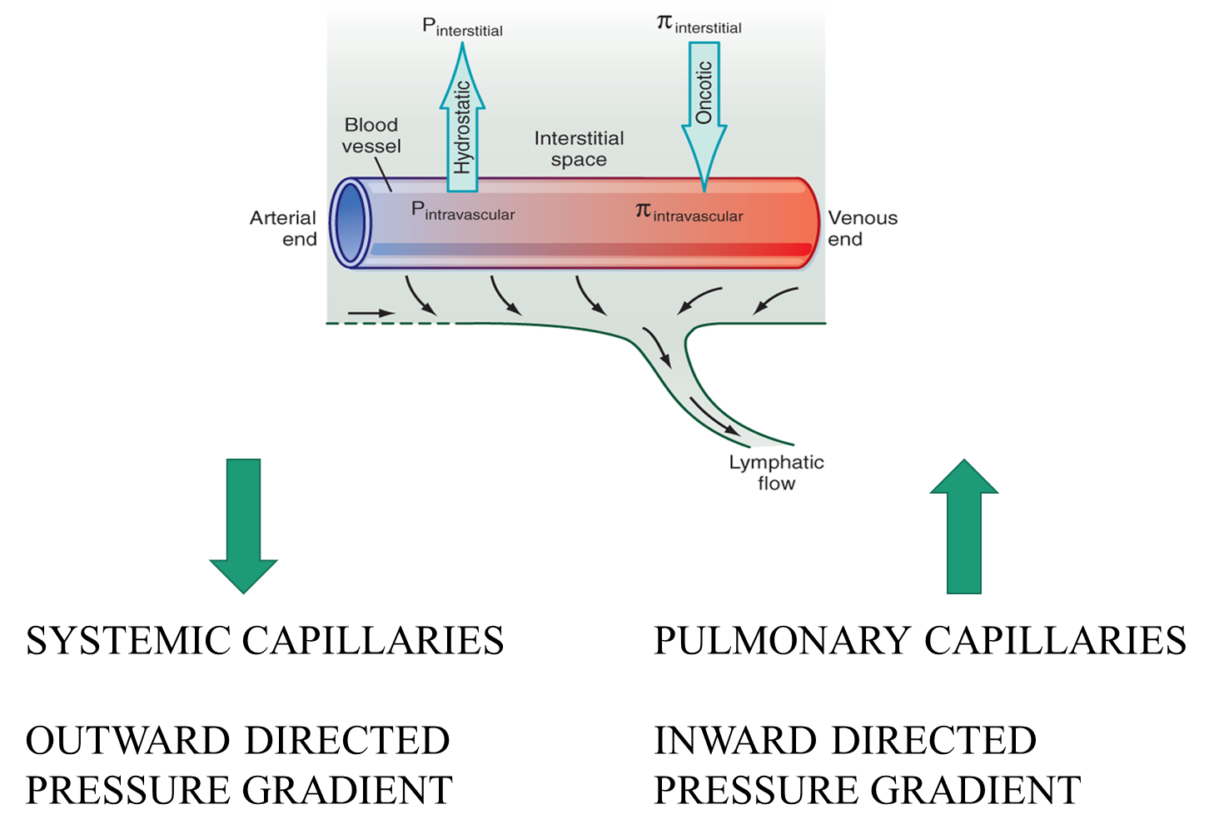

Slide 25
Reduction of fluid transudation
In the absence of surfactant, the transpulmonary pressure will be INCREASED, and would lead to a net pressure gradient acting outwards (about 20mmHg)
Surfactant reduces the surface tension, reduces the transpulmonary pressure and the net pressure gradient acts inwards
Alveoli remain ‘moist’

Slide 26
Disorders associated with surfactant
Lack of surfactant
Infant respiratory distress syndrome (IRDS)/ surfactant deficient disorder (SDD)
Syndrome in premature infants caused by developmental insufficiency of surfactant
Excess surfactant
Respiratory distress and pulmonary alveolar proteinosis
Rare condition where abnormal accumulation of surfactant occurs within the alveoli, interfering with gas exchange

Slide 27
Surfactant Deficient Disorder (SDD)
At birth : the 1st breath requires a marked change in intrapleural pressure (-20 to -30 mmHg change) to expand the atelectatic lungs
The 2nd breath needs only a slightly smaller pressure change as alveoli do not go back to fully collapsed state
In surfactant deficiency, lungs tend to collapse on expiration
Need high pressures to expand the lungs at every breath
Results in hypoxia
Increased work of breathing
Respiratory muscle exhaustion → ‘distress’
Hyaline membrane development

Slide 28
Basis of treatment of SDD
Mechanical ventilation(to do the work of breathing for the baby)
Supplemental oxygen (extra amounts of oxygen)
Continuous positive airway pressure (CPAP)
Surfactant replacement with artificial surfactant (human/ bovine) through the ET tube

Slide 29
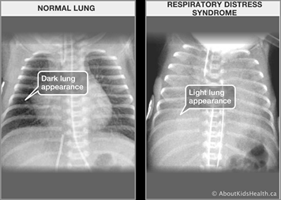
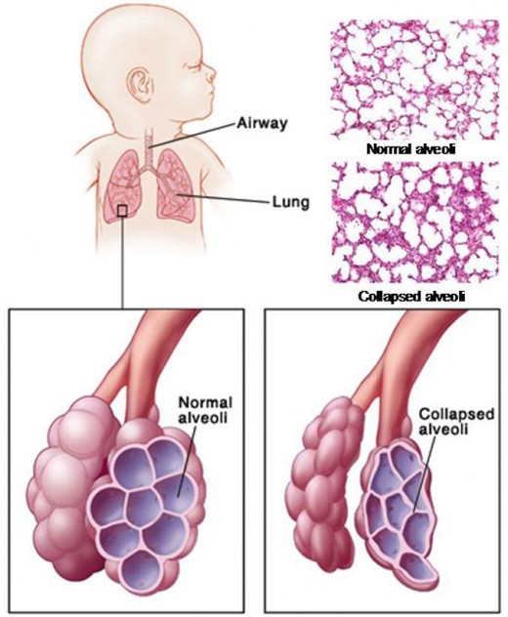
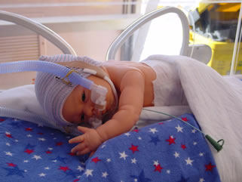
Lungs in SDD
CPAP

Slide 30
Prevention of SDD
Increase synthesis of surfactant using glucocorticoids
Administered to mother before the baby is delivered

Slide 31
Summary
Recoil tendency
Elasticity
Compliance
Elastance
Surface tension
Role of surfactant
Disorders associated with surfactant

